Slide 1
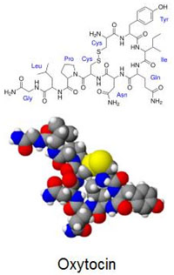
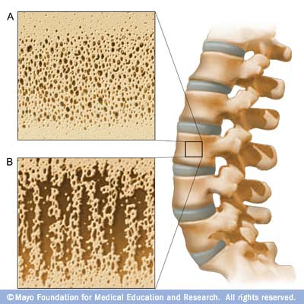
Oxytocin and bone remodeling: relationship between hormones and bone status
By
Joel Sandé
Osteoporosis

Slide 2

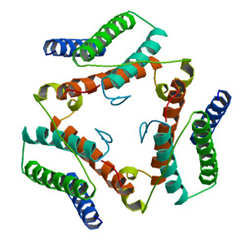
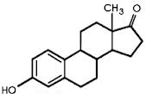
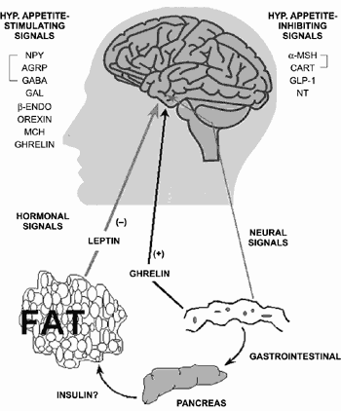
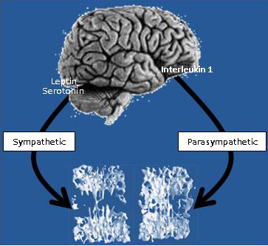
High
low
Oxytocin
regulate the secretion of Oxytocin
Estrogen
Leptine

Slide 3
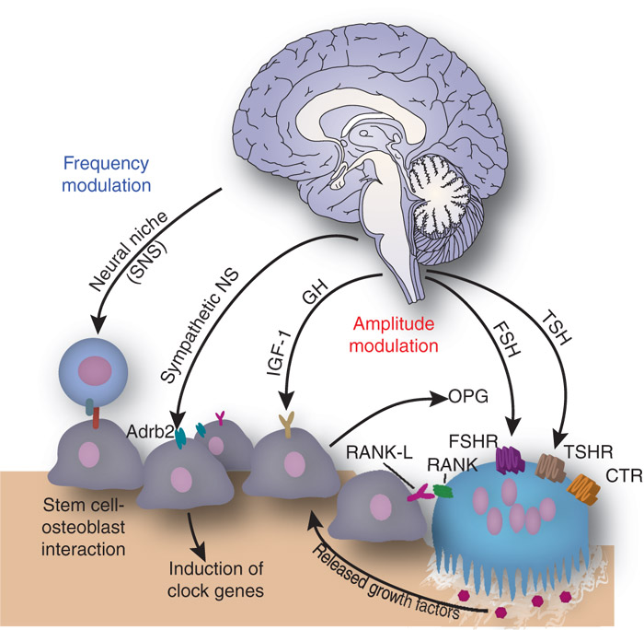
Method
20 postmenopausal women with severe osteoporosis compared to 16 healthy subjects controls.
Menopaused since at least 1 yr, 55 – 85 yrs.
Exclusion criteria were applied
treatment with certain drugs
diseases interfering with bone
They study the relationship between oxytocin and other hormonal factors known to regulate bone remodeling and body composition in osteoporosis

Slide 4
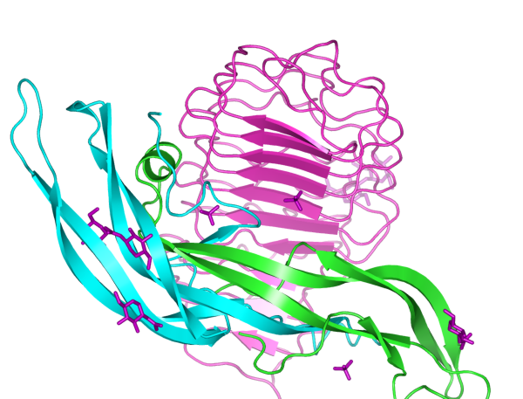
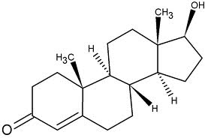
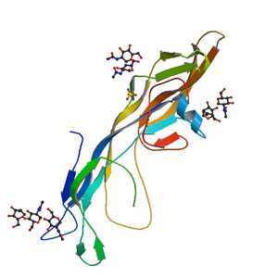
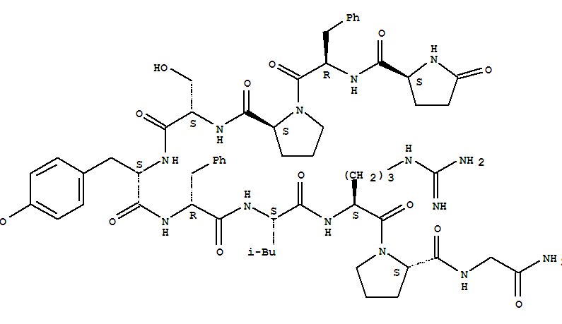
Method
Serum levels of
Testosteron
Oxytocin
Follicule Stimulating Hormone (FSH)
Luteinizing Hormone
(LH)
Thyroide Stimuling Hormone (TSH)
Leptine

Slide 5
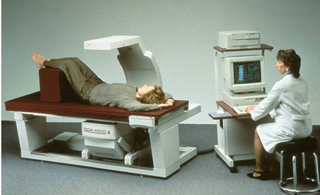
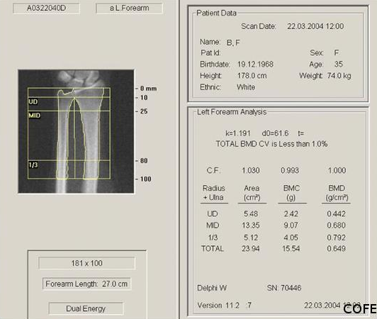
Method
Bone mineral density and body composition were also determined by X-ray absorptiometry (DEXA).

Slide 6
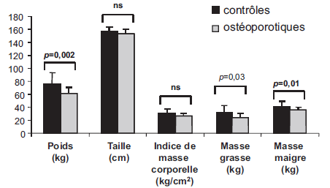
Results
Variables | Witnesses | Osteoporosis | P
Number of subject | 16 | 20
Age (yrs) | 67.3 | 73.25 | 0.04
Age of puberty (yrs) | 12.1 | 12.9 | NS
Age of menopausis | 50.1 | 47.8 | NS
Duration of the fertile period | 37.9 | 34.9 | NS
Number of fracturation | 0 | 2.6 | 0.8
Weight
Size
Fat mass
Lean body mass
Body Mass Indice

Slide 7
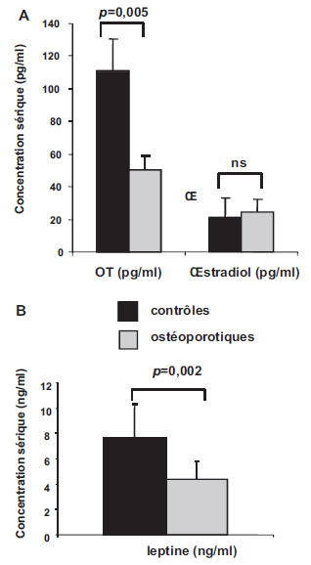
Results and Discussion
LH
TSH, Testosteron
(knowing that Ostragen and Leptin regulate Oxytocin)

Slide 8
Discussion
Serum levels of oxytocin were significantly correlated with bone mineral density regardless of Leptin, Estrogen and age.
Lean body mass and fat mass were lowered in women OP, but not BMI, identified as a risk classic osteoporosis.
The significant decrease of OT in serum OP women observed in the absence of significant changes in serum estrogen, testosteron enhances the role played by low OT in OP.

Slide 9
Conclusion
Low serum levels of Oxytocin appear to be associated with severe osteoporosis independent of other factors associated with osteoporosis or known to regulate serum levels of Oxytocin, such as Estradiol or Leptin, reinforcing the concept that :
Only a low Oxytocin is involved in osteoporosis.
Oxytocin may be involved in the pathophysiology of postmenopausal osteoporosis.
This opens a new therapeutic avenue in the support of ostoeporosis.

Slide 10

Reference
Véronique Breuila, Ez-Zoubir Amric, Patricia Panaia-Ferrarid, Jean Testae, Christian Elabdc, Christine Albert-Sabonnadièrea, Christian Hubert Rouxa, Gérard Ailhaudc, Christian Danic, Georges F. Carleb, Liana Euller-Ziegler. Ocytocine et remodelage osseux : relation entre hormones pituitaires, statut osseux et composition corporelle. Elsevier Masson, 2011.

